Slide 1

STUDENT RESULT ANALYSIS USING PYTHON LIBRARIES

Slide 2
PROJECT DISCRIPTION
Objective: The primary objective of this project was to analyze a student results dataset obtained from Kaggle to uncover key insights related to student performance and identify trends that can help predict future outcomes.
Tools & Technologies:
Programming Language: Python
Libraries Used: Pandas, NumPy, Matplotlib, Seaborn, Scikit-learn
Project Summary: In this project, I performed a detailed analysis of a student results dataset using Python and its associated libraries. The goal was to investigate various factors affecting student performance and derive meaningful insights to assist educators in improving teaching strategies.

Slide 3
DATASET & PYTHON CODE
Dataset link : https://www.kaggle.com/datasets/desalegngeb/students-exam-scores
Python Code :
import numpy as np
import pandas as pd
import matplotlib.pyplot as plt
import seaborn as sns
df = pd.read_csv("Expanded_data_with_more_features.csv")
print(df.head())
print(df.describe())
print(df.info())
print(df.isnull().sum())

Slide 4
df = df.drop("Unnamed: 0",axis=1)
print(df.head())
ax=sns.countplot(data=df,x="Gender")
ax.bar_label(ax.containers[0])
plt.title("Gender Distribution")
plt.show()
gb = df.groupby("ParentEduc").agg({"MathScore": 'mean',"ReadingScore":'mean',"WritingScore":'mean'})
print(gb)
sns.heatmap(gb,annot=True)
gb = df.groupby("ParentEduc").agg({"MathScore": 'mean',"ReadingScore":'mean',"WritingScore":'mean'})
print(gb)
sns.heatmap(gb,annot=True)
gb1 = df.groupby("ParentMaritalStatus").agg({"MathScore": 'mean',"ReadingScore":'mean',"WritingScore":'mean'})
print(gb1)
sns.heatmap(gb1,annot=True)
plt.title("Marks Distribution According to Parents Marital Status")
plt.show()

Slide 5
sns.boxplot(data=df,x="MathScore")
plt.title("Maths Score")
plt.show()
sns.boxplot(data=df,x="ReadingScore")
plt.title("Reading Score")
plt.show()
sns.boxplot(data=df,x="WritingScore")
plt.title("Writing Score")
plt.show()
print(df["EthnicGroup"].unique())
groupA=df.loc[(df["EthnicGroup"]=="group A" )].count()
groupB=df.loc[(df["EthnicGroup"]=="group B" )].count()
groupC=df.loc[(df["EthnicGroup"]=="group C" )].count()
groupD=df.loc[(df["EthnicGroup"]=="group D" )].count()
groupE=df.loc[(df["EthnicGroup"]=="group E" )].count()
l=["group A","group B","group C","group D","group E"]
mylist=[groupA["EthnicGroup"],groupB["EthnicGroup"],groupC["EthnicGroup"],groupD["EthnicGroup"],groupE["EthnicGroup"]]
plt.pie(mylist,labels=l,autopct="%1.2f%%")
plt.title("Distribution Of Ethnic Groups")
plt.show()

Slide 6
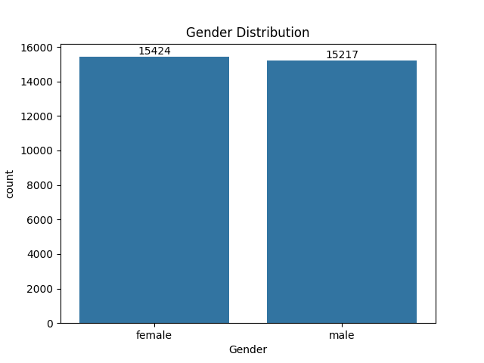
OUTCOMES

Slide 7
The bar chart illustrates the gender distribution of students in the dataset. From this visual, we can draw the following conclusions:
Near-Equal Gender Distribution: The dataset contains nearly equal numbers of male and female students. There are 15,424 female students and 15,217 male students, showing a balanced representation between the two genders.
Slight Female Dominance: While the difference is minimal, there are slightly more female students than male students in the dataset. However, this difference is insignificant and does not suggest any strong gender imbalance in the dataset.
Implication for Further Analysis: Since the gender distribution is relatively balanced, any gender-based performance analysis (e.g., comparing scores by gender) would not be heavily skewed by an imbalanced sample size. This provides a fair basis for comparing male and female student performance.

Slide 8
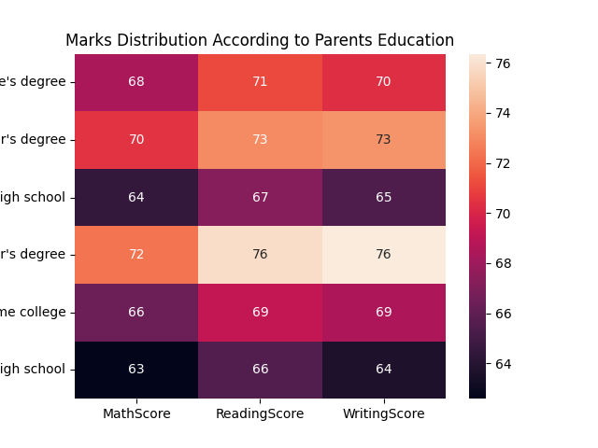

Slide 9
This heatmap shows the marks distribution based on parental education levels across three subjects: Math, Reading, and Writing.
Conclusions:
Higher Parental Education Correlates with Better Scores: Students whose parents have a master's degree tend to score the highest in all three subjects, with 76 in both Reading and Writing, and 72 in Math. This suggests a strong positive correlation between higher parental education and student performance.
Lower Parental Education Linked to Lower Scores: Students whose parents have a high school education tend to score the lowest, with 63 in Math, 66 in Reading, and 64 in Writing. This indicates that students from less educated backgrounds may require additional support to perform better.
Variation Across Subjects: Students with parents holding a bachelor's degree perform consistently well, scoring 70+ across all subjects, especially in Reading and Writing. On the other hand, the gap between subjects widens for students with lower parental education, where Reading scores tend to be slightly higher.

Slide 10
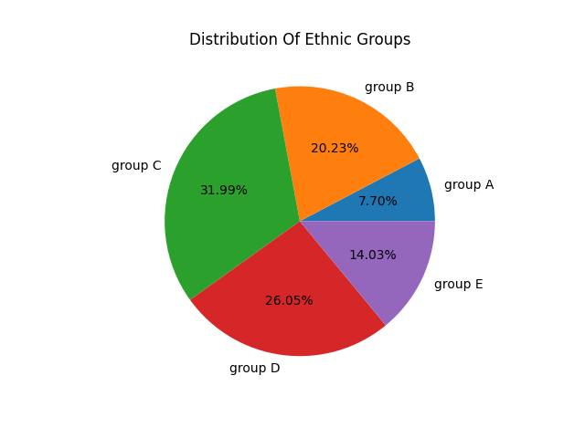

Slide 11
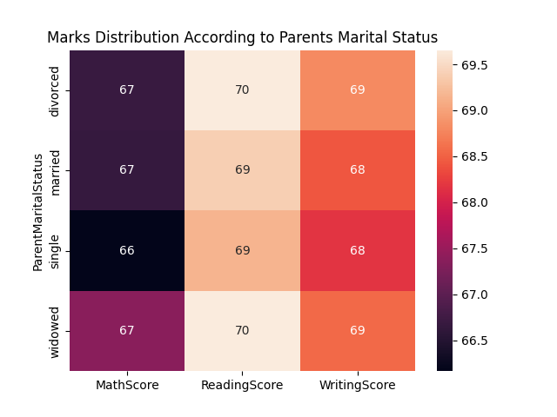

Slide 12
This heatmap shows the marks distribution based on parental marital status across three subjects: Math, Reading, and Writing.
Conclusions:
By this heatmap we can conclude that the marks of the students are not affected by their parents marital status as it was affected by the education background .
So this pretty much conclude that the parent marital status doesn’t play a major role on students performance in the subjects.

Slide 13
Conclusion
The project successfully provided a comprehensive analysis of the factors affecting student results and enabled predictions about student performance. The insights gained could be valuable for improving educational strategies and identifying students in need of additional support.

